Slide 1
Object Localization
Overview

Slide 2
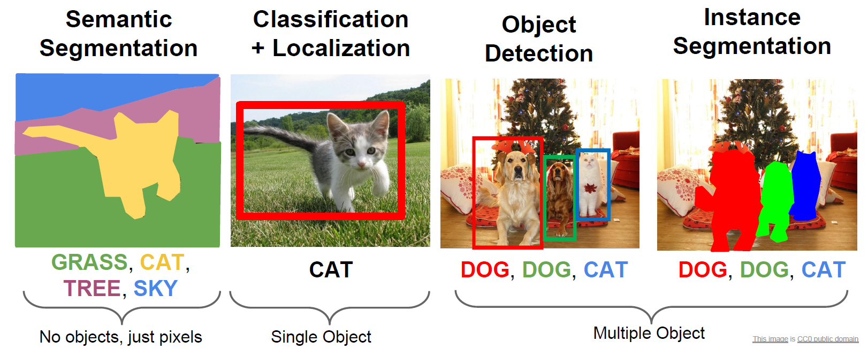
Computer Vision Task

Slide 3
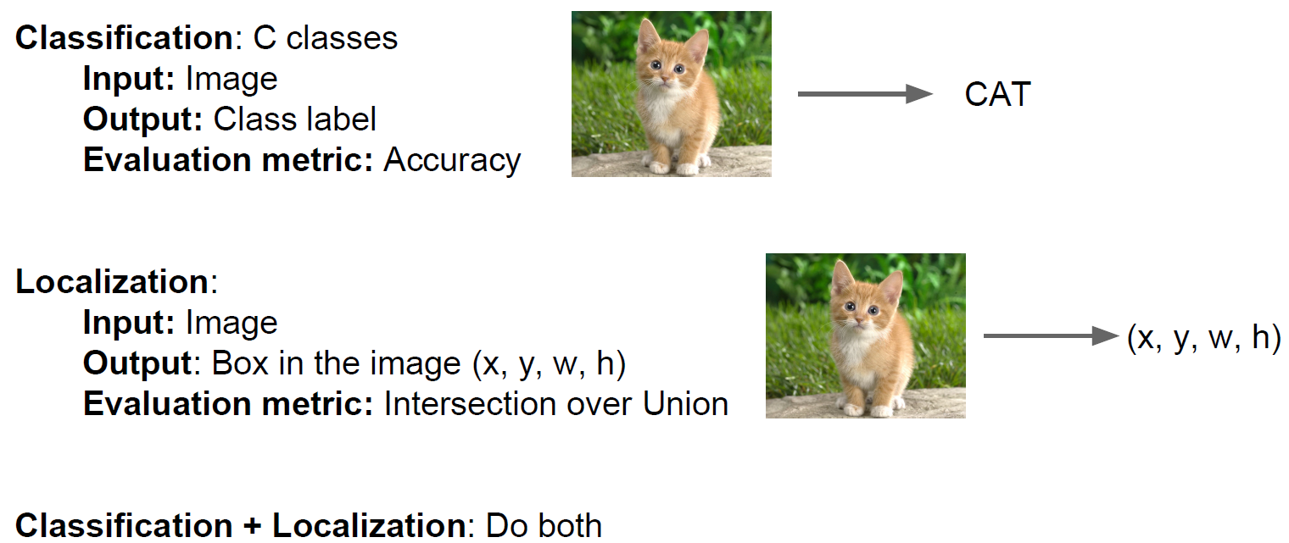
Classification + Localization

Slide 4
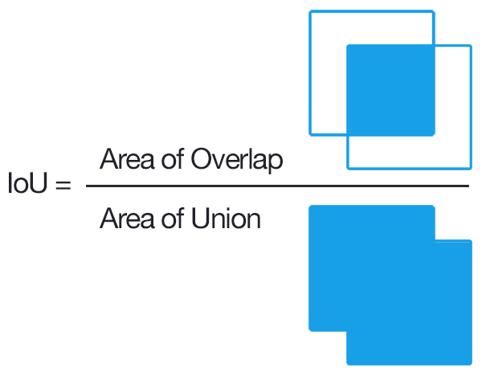
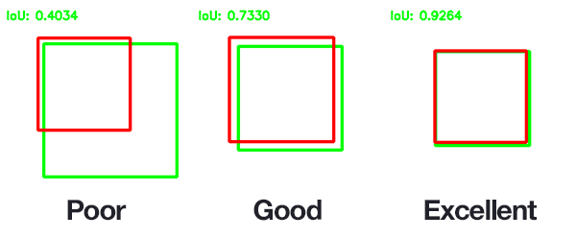
Intersection Over Union
Jaccard Overlap =

Slide 5
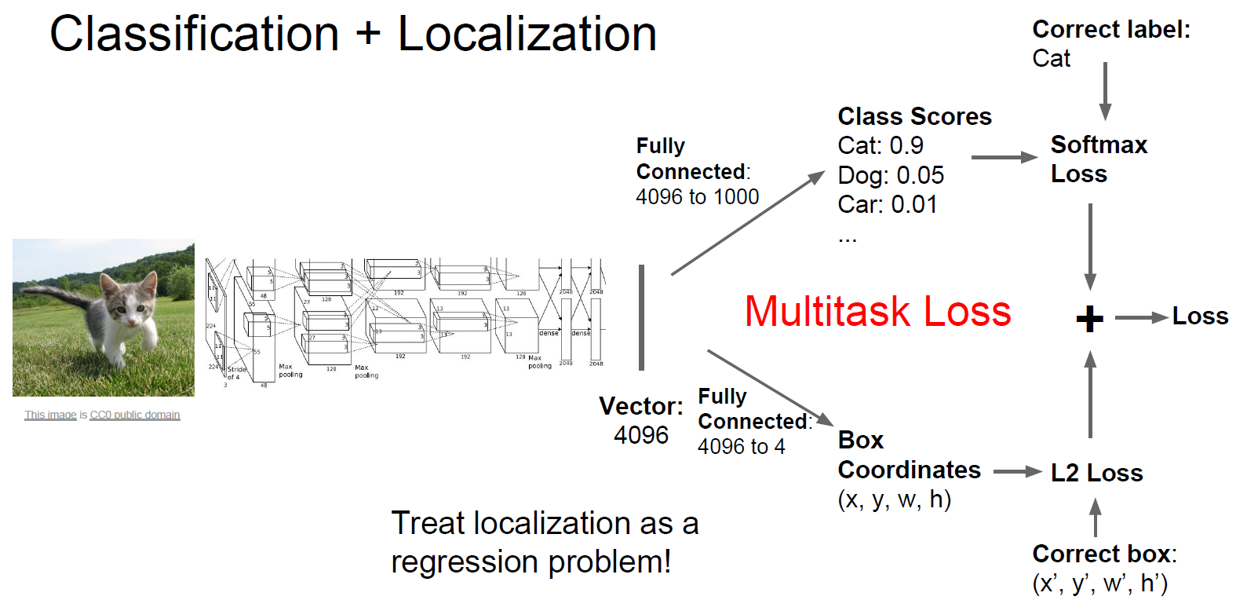
Classification + Localization

Slide 6
Classification + Localization

